Slide 1
Course Title: 5G and Wireless Technology
Course Code : ECE829
CLASS 17,18,19
Dated 24 March 2025
MODULE 1 of the Syllabus:-
Mobile Fading Channels
Prof.(Dr.) Rabindranath Bera (Professor, IIIT, KALYANI)
E-mail: rbera@iiitkalyani.ac.in; Mobile : 9475513358

Slide 2
Outline of Presentation
Radio wave Propagation
Time spreading
Doppler Spreading
Fading Channel Summary

Slide 3




Free Space Propagation
Top
12.1
Only attenuation and AWGN present in the channel:
Transmitter
Receiver
d
No objects present
Power attenuation due to
distance, inverse square law:
No reflections
No power absorption by the medium
L(d) = ^{⎛ 4}----^{π}----^{d}-^{⎞ 2}
⎝ λ ⎠

Slide 4


Notes:
The free space model assumes the following:
Mobile Fading Channels
Top
The space between antennas is free of objects that might reflect or absorb the radio signal
The atmosphere is a uniform and non absorbing medium
The antenna heights is infinite, therefore the earth is infinitely away from the propagating signal; equivalently the reflection coefficient can be assumed negligible.
Under these conditions, the radio frequency power is attenuated according to an inverse-square law, for an isotropic antenna this attenuation is
L(d) = ^{⎛ 4}----^{π}----^{d}-^{⎞ 2}
⎝ λ ⎠
where d is the distance between antennas and λ is the carrier frequency wavelength. Under the free space assumption, the received power can be easily calculated.
Ver 09.725

Slide 5

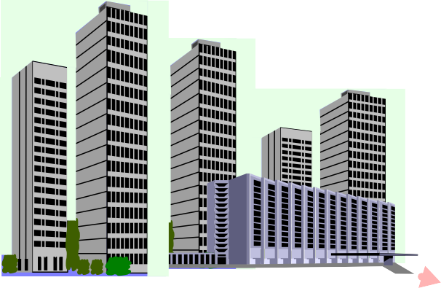
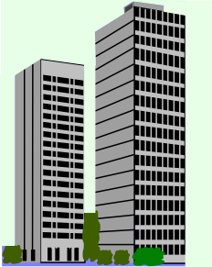

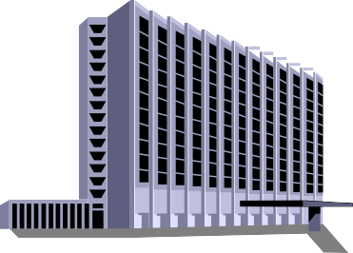
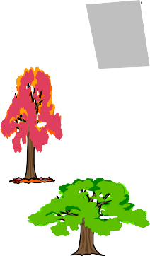










Multipath Propagation, Fading
Top
12.2
A more realistic propagation scenario: multipath fading:
transmitter
receiver

Slide 6








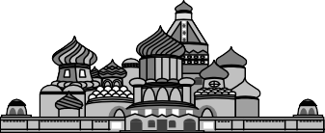
Multipath Fading
Top
12.3
Fading: fluctuation in the received signal power due to:
variations in the received signal amplitude:
A₁
A₂ < A₁
A₂
variations in the received signal phase:
φ₁
φ₁ ≠ φ₂
φ
2
variations in the received signal angle of arrival:
ϕ₁
ϕ₁ ≠ ϕ₂
ϕ₂

Slide 7
Notes:
Mobile Fading Channels
Top
The presence of objects on the radio signal path produces attenuation of its power as they can scatter or absorb part of the signal power, thus producing a variation of the amplitude.
Paths travelling different distances may arrive at the receiver with different phases as well as angle of arrival.
Ver 09.725

Slide 8
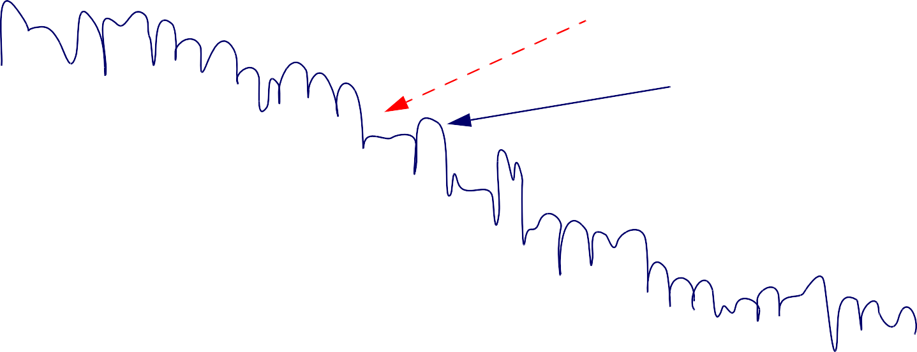
Large Scale & Small Scale Fading
Top
12.4
Large scale fading: average signal power attenuation or path loss due to motion over large areas;
Small scale fading: large variations of the signal amplitude due to small changes in the distance between transmitter and receiver (also called Rayleigh fading if there is no direct line of sight (LOS) between transmitter and receiver):
signal power (dB)
large scale fading
small scale fading
antenna position

Slide 9
Notes:
Mobile Fading Channels
Top
Large scale fading is due to movement of the transmitter or the receiver (or both) over large areas. The path between them is shadowed by prominent terrain contours such as hills or forests. This kind of fading is characterised by a mean path loss and a log-normally distributed variation about the mean. An estimate of the path loss as a function of the distance can be calculated using these statistics.
Small scale fading is due to small changes in distance (half wavelength) between transmitter and receiver. If the number of paths is large enough and there is no direct line of sight (LOS) between transmitter and receiver the envelope of the received signal can be statistically characterised by a Rayleigh pdf, thus this fading is also called Rayleigh fading. In case there is a direct LOS propagation path, the statistical distribution of the received envelope is Rician.
Ver 09.725

Slide 10
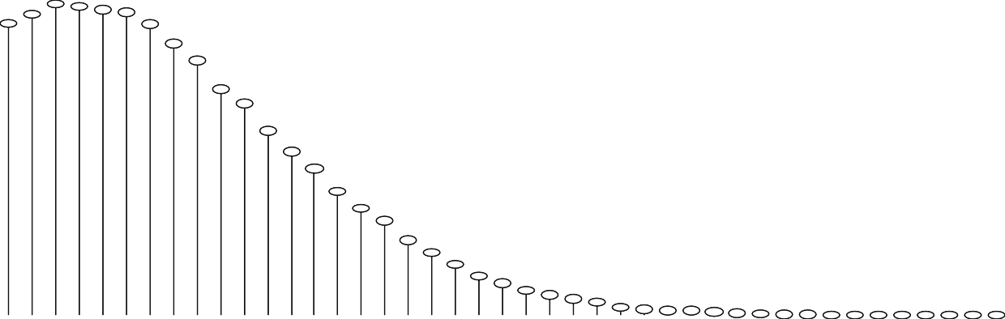
Rayleigh Fading Mechanisms
Top
12.5
Rayleigh fading manifests itself in two mechanisms:
Time spreading introduced by the channel due to multipath (time dispersion);
Time-variant behaviour of the channel due to motion and changes in the propagation paths.
Rayleigh PDF:
SystemView
0
1
2
3
4
4.e+3
3.5e+3
3.e+3
2.5e+3
2.e+3
1.5e+3
1.e+3
500
0
Bin Count
0
1
2
Amplitude
3
4

Slide 11


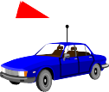

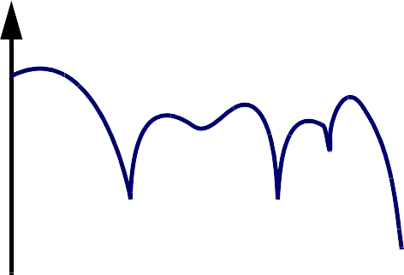
Time spreading
Top
12.6
Multiple paths in the channel: signal arrives at the receiver delayed and attenuated:
finger 2
h(t)
finger 1
τ₂
P₂
τ_{1 P}
1
finger 3
impulse response
τ₃
P₃
τ₁ τ₂ τ₃
time
single signal is spread in time due to multipath
channel frequency response
ℑ⎨h(t)⎬ = H(f)
|H(f)|²
different frequencies suffer different attenuations
freq

Slide 12









Time variant behaviour of the channel
Top
12.10
Relative movement between transmitter and receiver or of bodies between them produces a spreading of the transmitted signal frequencies: Doppler effect:
finger 2
v'_{m}
h(t)
finger 1
τ₂
P₂
τ_{1 P}
1
finger 3
impulse response
τ₃
P₃
v_{m}
τ₁ τ₂ τ₃
time
v'_{m}
h˜ (t)
finger 1
finger 2
_{τ}˜₂
2
_{τ}˜_{1 ˜}
P₁
_{P}˜
finger 3
impulse response
_{τ}˜_{3 P}˜ ₃
_{τ}˜_{1 τ}˜_{3 τ}˜₂
time
v_{m}

Slide 13
Notes:
Mobile Fading Channels
Top
The time variance of the channel is an important factor to take into account when designing a mobile communication system. Fast variations in the channel can cause severe pulse distortion and loss of SNR which can lead to irreducible BER.
Distorted pulses can cause synchronization problems, yielding to PLL failure, as well as problems tracking channel variations by equalizers, which will have to be re-trained more often in order to cope with the channel changing rate.
Ver 09.725

Slide 14

Doppler effect
Top
12.11
When transmitter and receiver are in relative motion the received carrier frequency is shifted relative to the transmitted carrier frequency;
Doppler effect: single path case:
propagation time, function of time:
v_{m}
d(t)
d₀ – v_{m}t v_{m}t
τ(t) = --------- = -------------------- = τ₀ – --------
d
0
c
c
c
transmitted signal: cos (2πf_{c}t)
c speed of light
f_{c} carrier frequency
received signal:
v_{m}t ⎞
cos[2πf (t – τ(t))] = cos 2πf ⎛t – τ₀ + -------- ⎠
= cos [2π(f
+ f )t – φ]
c
c⎝
c
c d
v
m
Doppler frequency shift f =
------
f
phase term φ = 2πf τ
d
c
c
c 0

Slide 15
Notes:
Mobile Fading Channels
Top
A positive or negative Doppler frequency shift appears depending on whether the transmitter is moving toward or away from the receiver. As an example, a person walking at ±3 miles/hr will cause a Doppler shift of ±4 Hz when the carrier frequency is 910MHz. For the same person travelling in a car at a speed of ±60 miles/hr, the Doppler shift introduced will be of ±80 Hz.
Ver 09.725

Slide 16

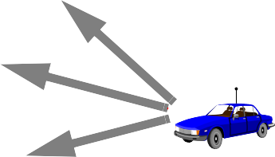

Doppler spectrum
Top
12.12
Doppler effect: multipath case:
finger 2
Different paths have different speed components
v_{m} ≠ v'_{m} ≠ v''_{m}
different Doppler shift for each path
v_{m} f_{d} v'_{m} f '_{d} v''_{m} f ''_{d}
v'_{m}
finger 1
v
m
finger 3
v''_{m}
When transmitting a sinusoid, three shifted sinusoids are received
Y(f)
X(f)
f_{c}
freq.
Doppler spread
f_{c} + f_{d} f_{c} + f '_{d}
freq.
f_{c} + f ''_{d}
With multipath: we talk about Doppler spectrum and not Doppler shift.

Slide 17
Notes:
Mobile Fading Channels
Top
In a realistic multipath case, when a single sinusoid is transmitted, instead of being subjected to a simple Doppler shift, it is spread in frequency and is received as a spectrum, called Doppler spectrum. This happens when there is relative movement between transmitter and receiver or when there are moving objects in the transmission path as this produces time variant multipath characteristics.
For a Rayleigh channel the classical Doppler spectrum is [17]
D(f) = -----¹------[1 – (f ⁄ f )²]^{1 ⁄ 2}
f ≤ f
2πf_{d}
d
d
where f_{d} = v_{m}f_{c} ⁄ c is the maximum Doppler shift
D(f)
Doppler power spectrum
f_{c} – f_{d} f_{c} f_{c} + f_{d}
freq.
Another Doppler spectrum model used is the flat spectrum model [17], which is flat over a range of frequencies symmetric to the carrier frequency
D(f) = -----¹------ f ≤ f_{d}
2πf_{d}
[17]K. Pahlaven, A.H. Levesque. Wireless Information Networks. John Wiley & Sons, 1995.
Ver 09.725

Slide 18
Time variant channel: coherence time
Top
12.13
Time variant channel produces fading: as terminals move and paths change, power fluctuates at the receiver;
Coherence time T₀ : Expected time duration over which the channel’s response is essentially invariant;
Approximate relation between T₀ and f_{d} (Doppler spread):
T₀ ≈ -¹---
f_{d}

Slide 19
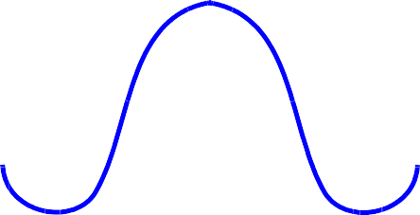
Notes:
Mobile Fading Channels
Top
The function R(t) called the space time correlation function shown below is the autocorrelation function of the channel response to a sinusoid. This function indicates the amount of correlation between the channel response to a sinusoid sent at time t₁ and the response to another sinusoid sent at time t₂ .
Fourier transform
D(f)
Doppler power spectrum
T₀
R(t)
t
freq.
0
f – f
f
f + f
c d
c
c d
Therefore, the width of the main pulse in R(t) is T₀ or coherence time which is a measure of the period of time over which the channel’s response is invariant.
Ver 09.725

Slide 20
Time variance: fast fading
Top
12.14
Fast fading:
T₀ < T_{s} T_{s} : symbol duration
Fading channel changes several times while a symbol is propagating;
Fast fading produces:
baseband pulse distortion
loss in SNR
synchronisation problems (failure of PLL)

Slide 21
Notes:
Mobile Fading Channels
Top
When fast fading occurs, the time when the channel behaves in a correlated manner is short compared to the duration of a symbol. Therefore the symbol will be distorted due to the fact that the received signal’s components are not correlated through time.
The fast fading condition:
T₀ < T_{s}
can also be expressed as:
W < f_{d}
where W ≈ --¹----
T_{s}
The distortion and loss of SNR produced by fast fading yields an irreducible error rate, that cannot be overcome by increasing E_{b} ⁄ N₀ [•].
P.A. Bello and B.D. Nelin. “The influence of fading spectrum on the binary error probabilities of incoherent and differentially coherent matched filter receiver”. IRE Trans. Commun. Sys., Vol. C-10, June 1962, pp. 160-68.
Ver 09.725

Slide 22
Time variance: slow fading
Top
12.15
Slow fading:
T₀ > T_{s} T_{s} : symbol duration
The channel remains invariant through the duration of a transmission symbol;
Slow fading produces:
Loss in SNR (as with flat fading).

Slide 23
Notes:
Mobile Fading Channels
Top
With slow fading, the duration in which the channel behaves in a correlated manner is long compared to the time duration of a transmission symbol. Therefore, the channel will remain virtually unchanged during the time a symbol is transmitted, which will not suffer any distortion.
Another condition for slow fading is:
W > f_{d}
When low data rate systems like Morse or teletype were in use, channels could often be considered as fast fading. However, when present high data rate systems are used, channels can generally be characterised as slow fading.
Ver 09.725

Slide 24
Fading Channel Summary
Top
12.16
mean attenuation vs. distance
fading channel manifestations
large scale fading
motion over large areas
variations about the mean
flat fading
time spreading of signal
frequency selective fading
fast fading slow fading
small scale fading
small changes in position
time variance of channel

